Slide 1
MERN-Based College Event Management
Group Project Presentation

Slide 2
Project Overview
Problem: Managing college events
Solution: MERN-based event platform
Records: name, date, venue, organizer

Slide 3
Overview
Problem Statement
College events are difficult to coordinate without a unified system. Event organizers struggle with managing event details such as name, date, time, venue, and participants across scattered tools. There is no centralized platform to track registrations, communicate updates, or provide role-based access for admins and students, leading to inefficiencies and miscommunication.
Proposed Solution
A centralized MERN-based web application will streamline college event management. The system will allow creation, viewing, updating, and management of event records and participants through an intuitive React frontend, backed by Node.js and Express.js REST APIs, with all data securely stored and managed in MongoDB.

Slide 4
Tech Architecture
Frontend
Backend
React.js is used to build the user interface for the college event management system. It renders dynamic event listings, registration forms, and dashboards. React components handle event creation, viewing, and updates. Role-based views are served to admins and students. State management ensures a smooth, responsive experience across all pages.
Node.js and Express.js power the REST API layer, handling all HTTP requests for event management. APIs support CRUD operations: adding, viewing, updating, and deleting events. MongoDB stores event data including name, date, time, venue, organizer, and participants. Authentication middleware enforces role-based access control for secure data management.

Slide 5
CRUD Operations
Add & View Events
Create new college events with details such as event name, date, time, venue, organizer, and participants. View all events in a structured list with full details rendered dynamically through the React.js frontend, fetching data via Express.js REST APIs from MongoDB collections.
Update & Manage Records
Edit and update existing event records including organizer assignments, venue changes, and participant lists. Delete outdated or cancelled events. Role-based access ensures only authorized users can modify or remove records, maintaining data integrity across the system.

Slide 6
Objectives
Demonstrate MERN Stack development by building a fully functional college event management system. Implement CRUD operations using MongoDB to manage event name, date, time, venue, organizer, and participants. Build RESTful APIs using Node.js and Express.js to handle all backend operations efficiently.
Develop an interactive and responsive frontend using React.js to provide a seamless user experience. Implement user authentication and role-based access control to secure the system. Display project information, event records, and results clearly through a well-structured interface.

Slide 7
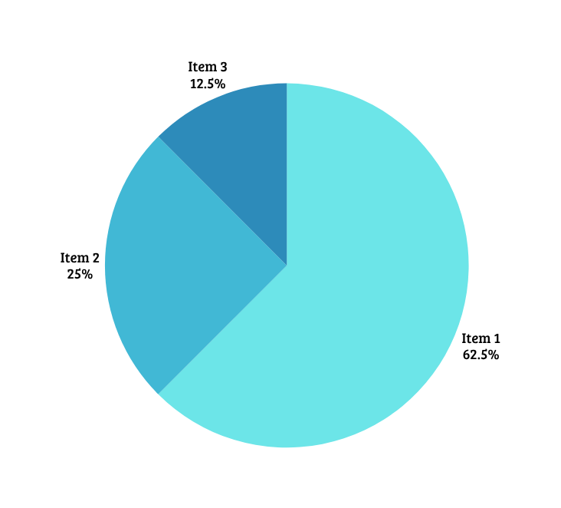
Result
The MERN-based college event management system delivers a fully functional event workflow. Users can seamlessly create, view, update, and delete events with organized storage of event name, date, time, venue, organizer, and participants. Secure role-based access ensures only authorized users can manage records, while React.js provides a clear and intuitive interface for displaying all project information and results effectively.

Slide 8
Thank You!

